Slide 1

Sports Betting with Data Science
By Justin Tunley

Slide 2
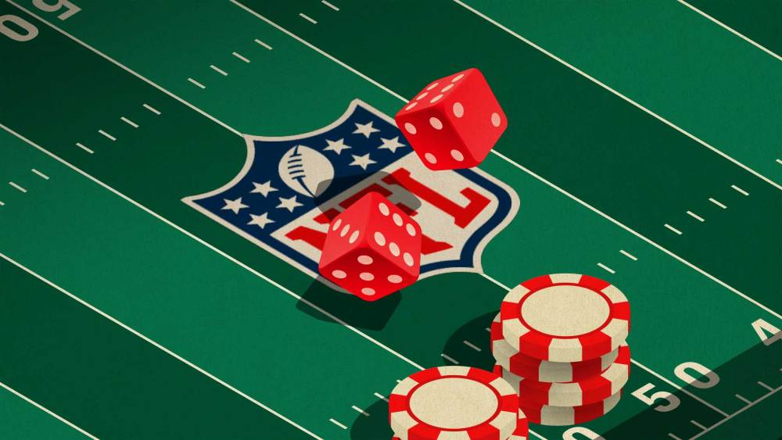
Problem Statement
How can we more accurately predict the outcome of NFL football games using advanced game analytics?

Slide 3
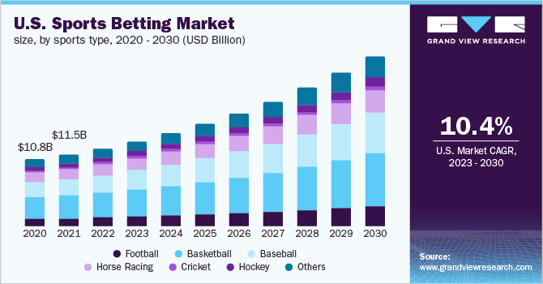
Opportunity and Impact
Opportunity
Online Sportsbooks
Create accurate lines that can help you make money
Household Bettors
Beat the system by finding advantageous bets
Team Analytics Departments
By understanding what actions translate into points scored, teams can make decisions that give them a better chance of winning.
Impact
Make people money!
Source: Grand View Research

Slide 4
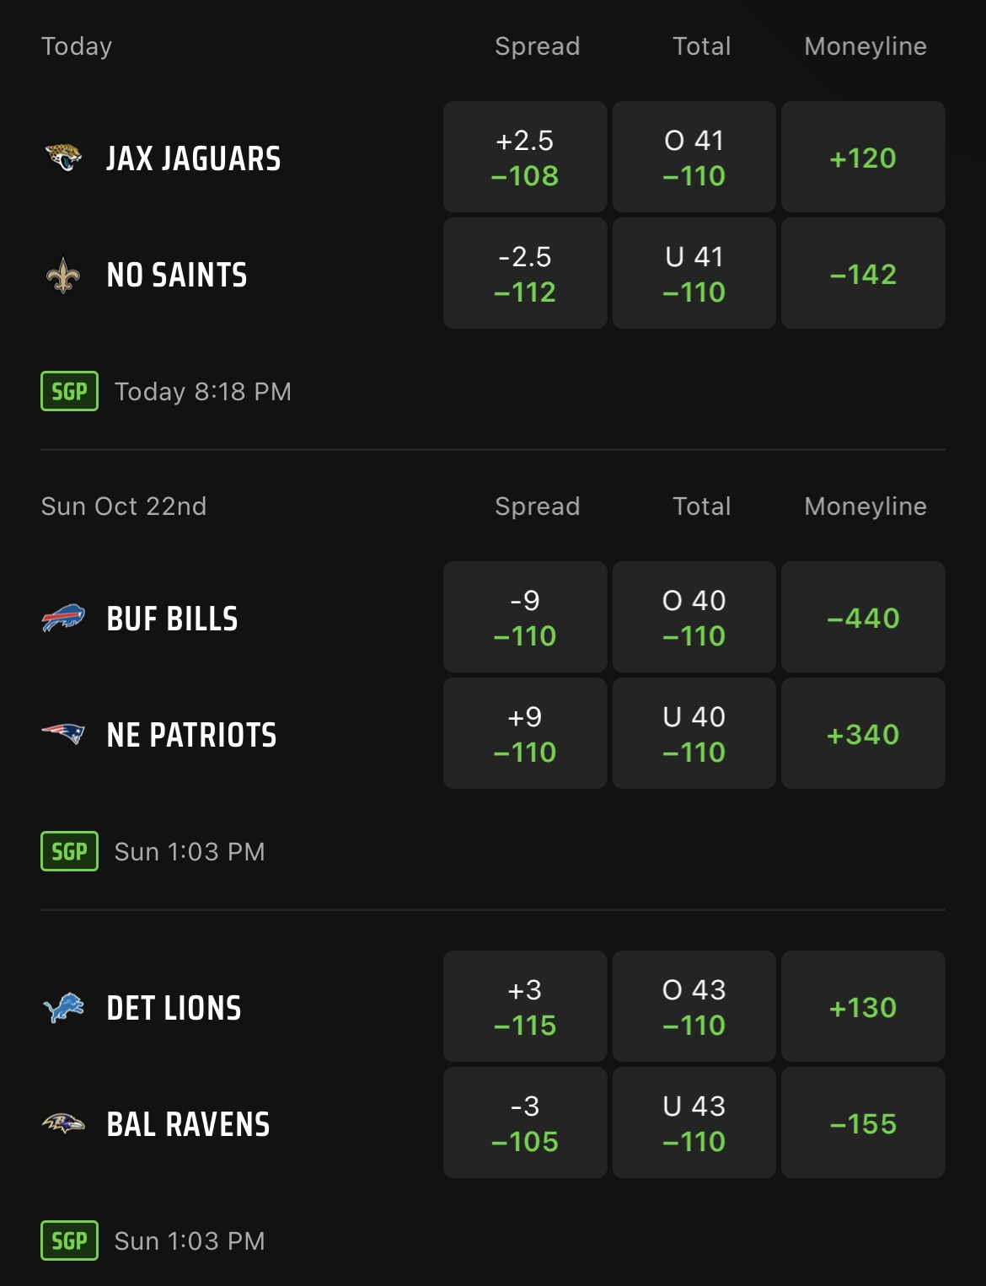
(A Final) Intro to Sports Betting
Key Terms
Moneyline: Who will win?
Compare expected points between home and away teams.
Spread: How much should the favored team win by?
The difference in expected points between teams.
Point Total (O/U)
The sum of expected points for both teams.
Solving with Data Science
2 Regression models:
Home Offense vs Away Defense --> Home Team Expected Points
Away Offense vs Home Defense --> Away Team Expected Points

Slide 5
Datasets and Preprocessing Approach
Datasets
Historical Team Data
Scraped from ESPN website
Every team in every year since 2004 (excluding playoffs)
Current-Season Team Data
Scraped from ESPN website
Individual Game Data
Outcomes, locations, weather and stadium data
Methodology
Scrape team statistics from a previous seasons on offense and defense.
Consolidate rows so one row is associated with one team in a particular season.
Create a new data frame with every conceivable matchup between teams in a season.
Merge game outcome data with all matchups that actually happened.
Remove rows where a matchup never occurred and train model to predict future outcomes based on current-season team data.

Slide 6
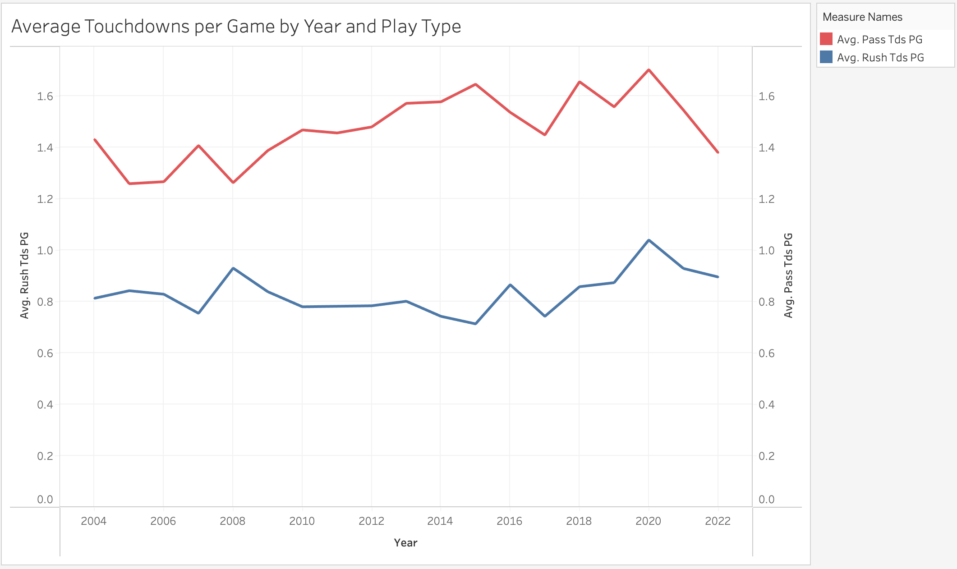
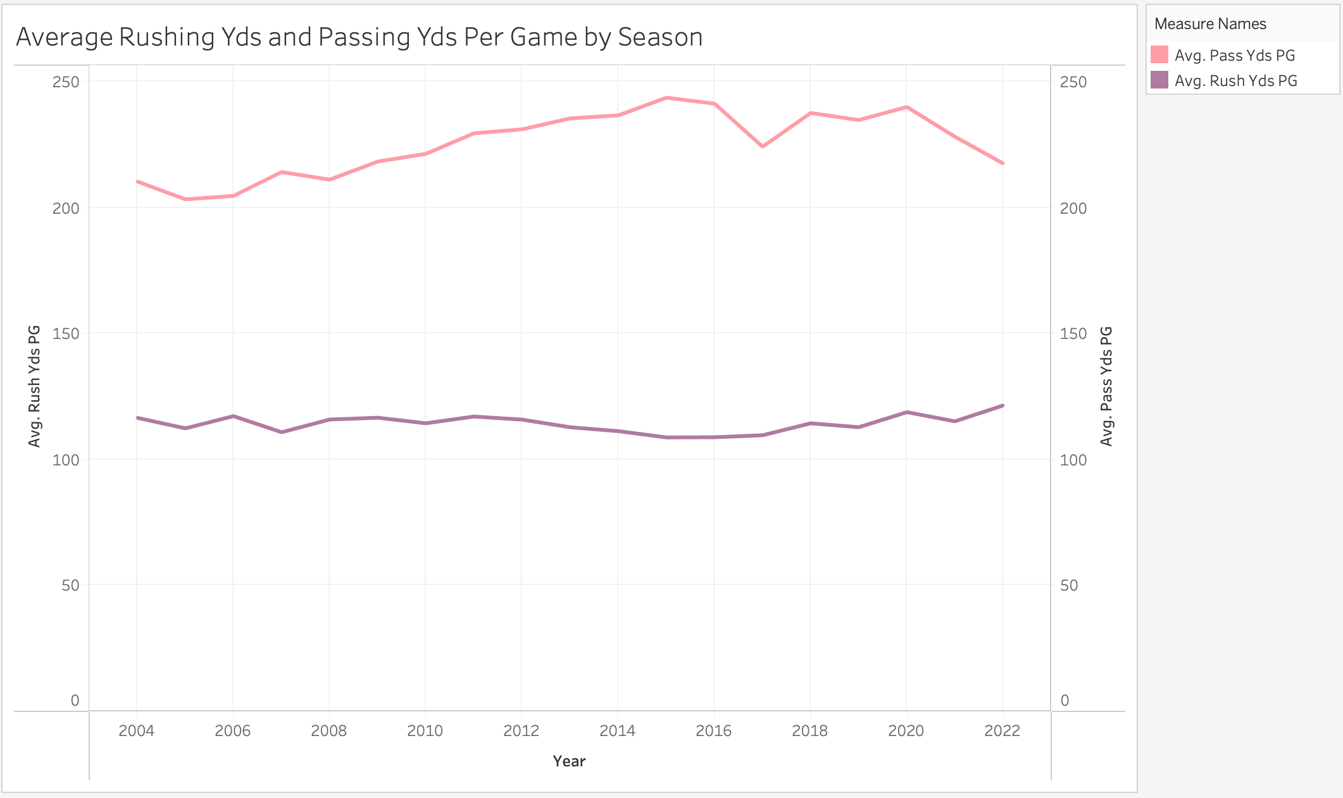
Key Findings: Changes in NFL Scoring Trends
Teams that are pass-heavy are much more likely to score more points than teams that are run-heavy. This does not mean they are more likely to win the game, only that they should be weighed differently when modeling for expected points.

Slide 7
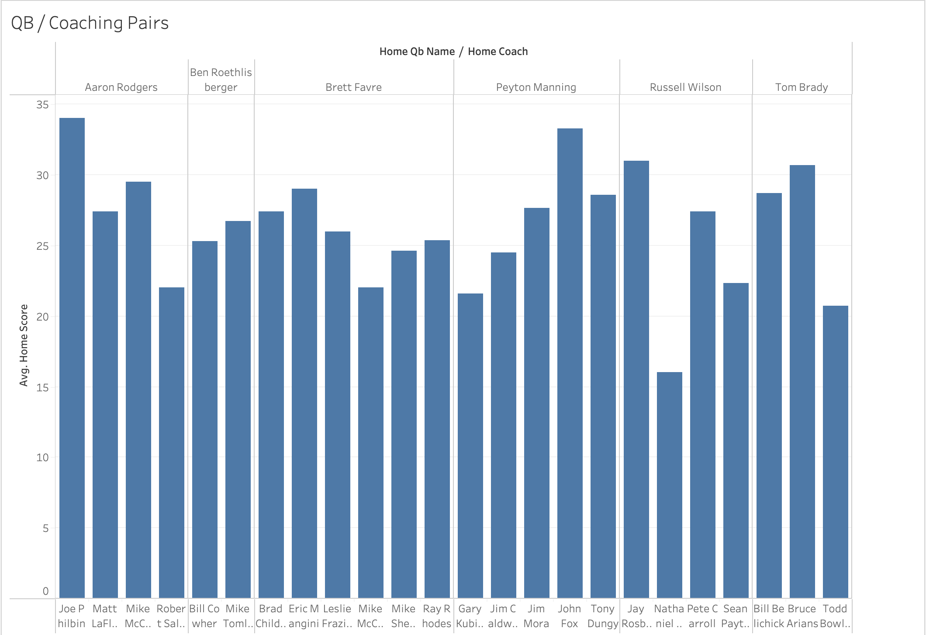
Key Findings: Predictors of an Excellent Team
What do all the best offenses have in common?
A great quarterback
A great head coach
Notable takeaway:
Quarterbacks that spend more time with a single coach tend to perform better.
Even the best quarterbacks cannot succeed without a coaching staff that supports their style of play.
Coaches should focus on creating a system that will work long-term, rather than give up on coaches in 3 years.

Slide 8
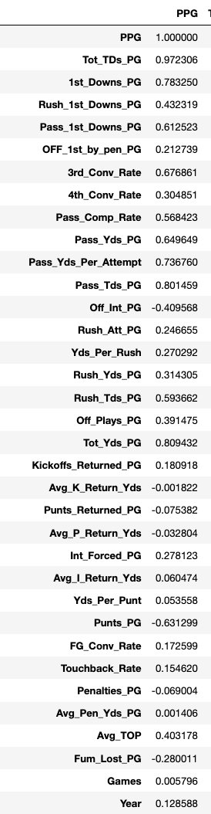
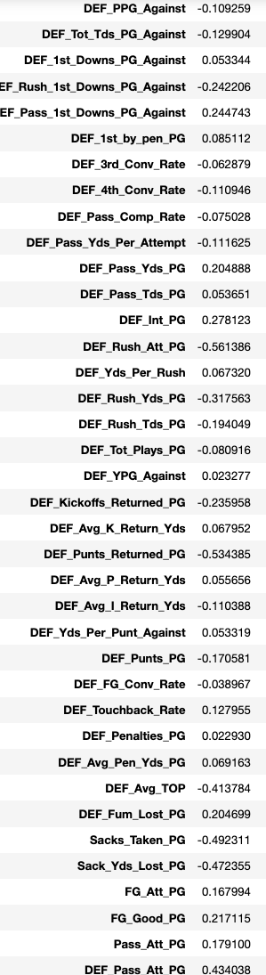
Key Findings: Feature Correlation
Which features are most correlated with Point Per Game?
Offense:
Total touchdowns: .97
Total 1st downs: .78
Passing 1st downs: .61
Passing yards per attempt: .73
Total yards per game: .81
Defense:
Rushing Attempts per game: -0.56

Slide 9
Key Findings: The Pointlessness of Special Teams
Myth: Special teams doesn’t matter
Fact: Special teams barely matters
- Beyond field-goal conversion rate, special teams doesn’t provide all that much in terms of increasing the likelihood of scoring points.
- Statistics say: stop returning kickoffs.
*Make another Tableau visual*

Slide 10
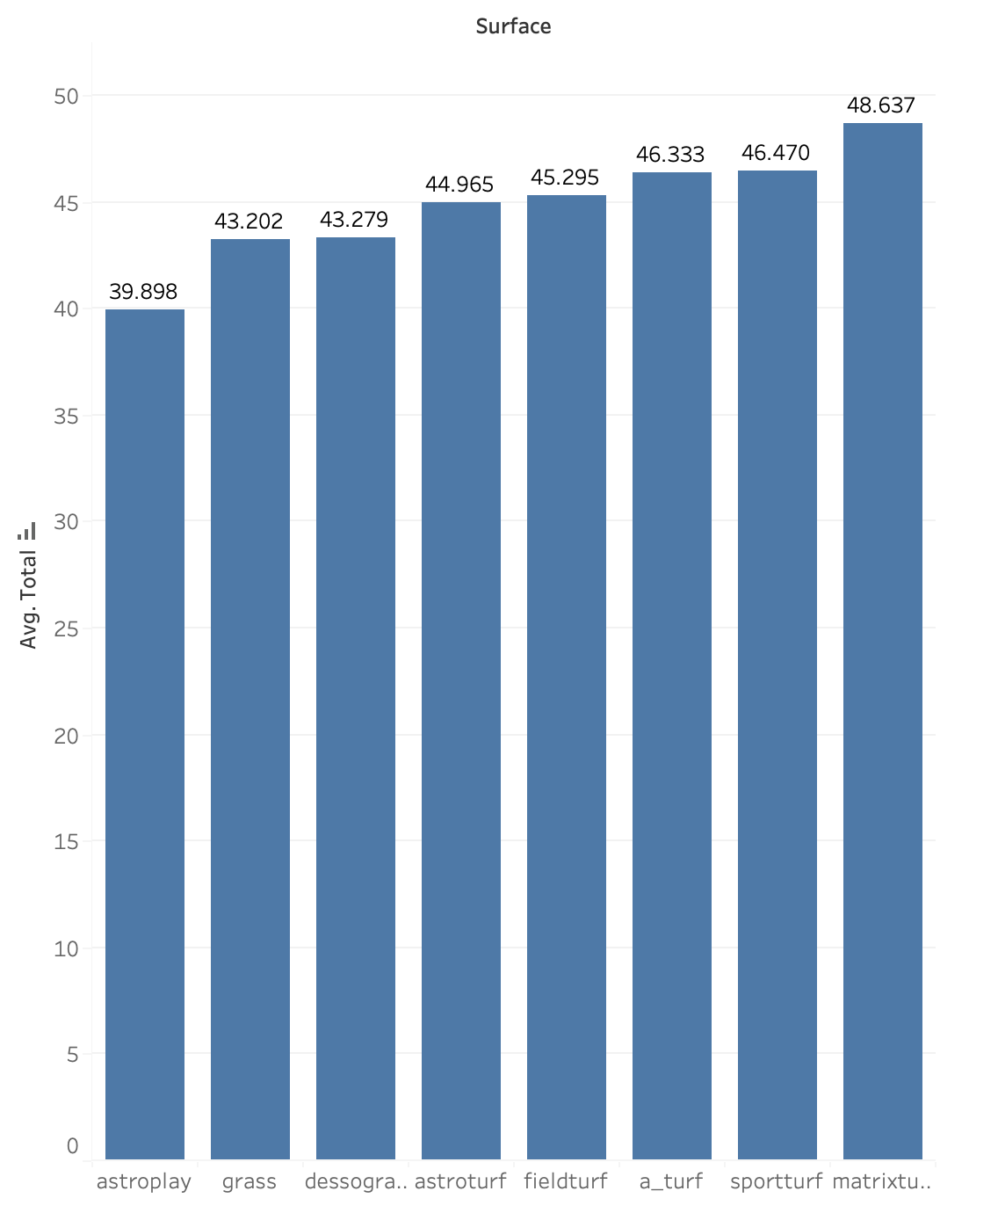
Key Findings: Settling the Grass vs Turf Debate
NFL owners claim playing on turf creates higher scoring games, which in turn are more interesting. Is there merit to these claims?
On the surface, yes.
Future insights:
How does field surface influence the likelihood of player injuries?
Compare the money lost on player injuries to the money gained from artificially boosting game score.
While turf make make games more interesting for viewers, my goal is to prove that injuries to players outweighs the impact of higher-scoring games.

Slide 11
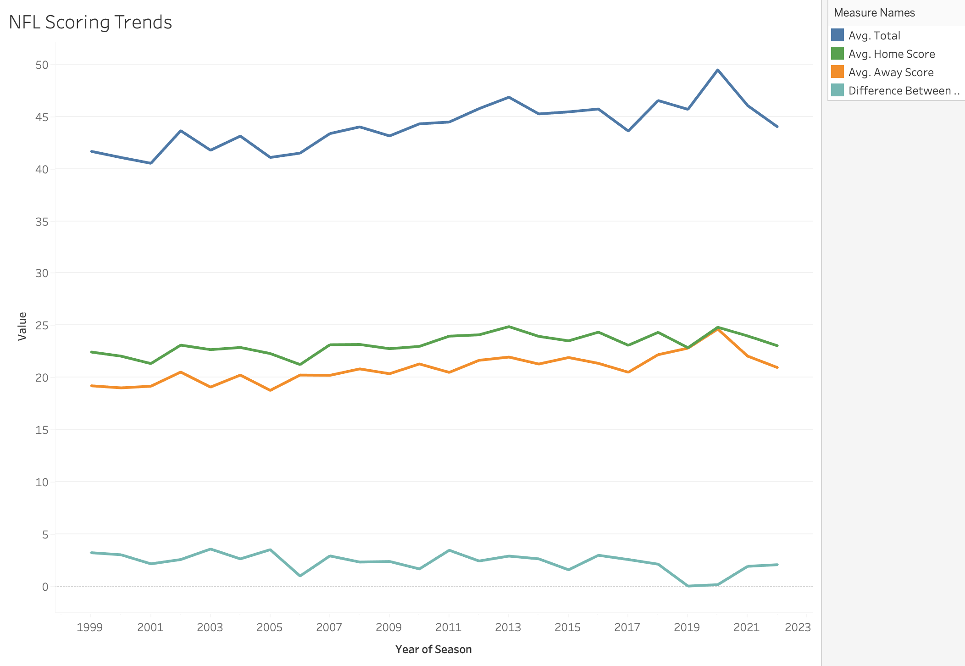
Key Findings: Impact of the 12th Man
Does playing at home truly give you a competitive advantage?
Vegas gives a 3-point bonus to home teams.
The difference between home and away score varies by year, but is consistently around 3 points.
Myth: Confirmed
Future insights:
Is there a way to determine where this advantage comes from? Is it all mental, or can climate and field surface be playing a role?

Slide 12
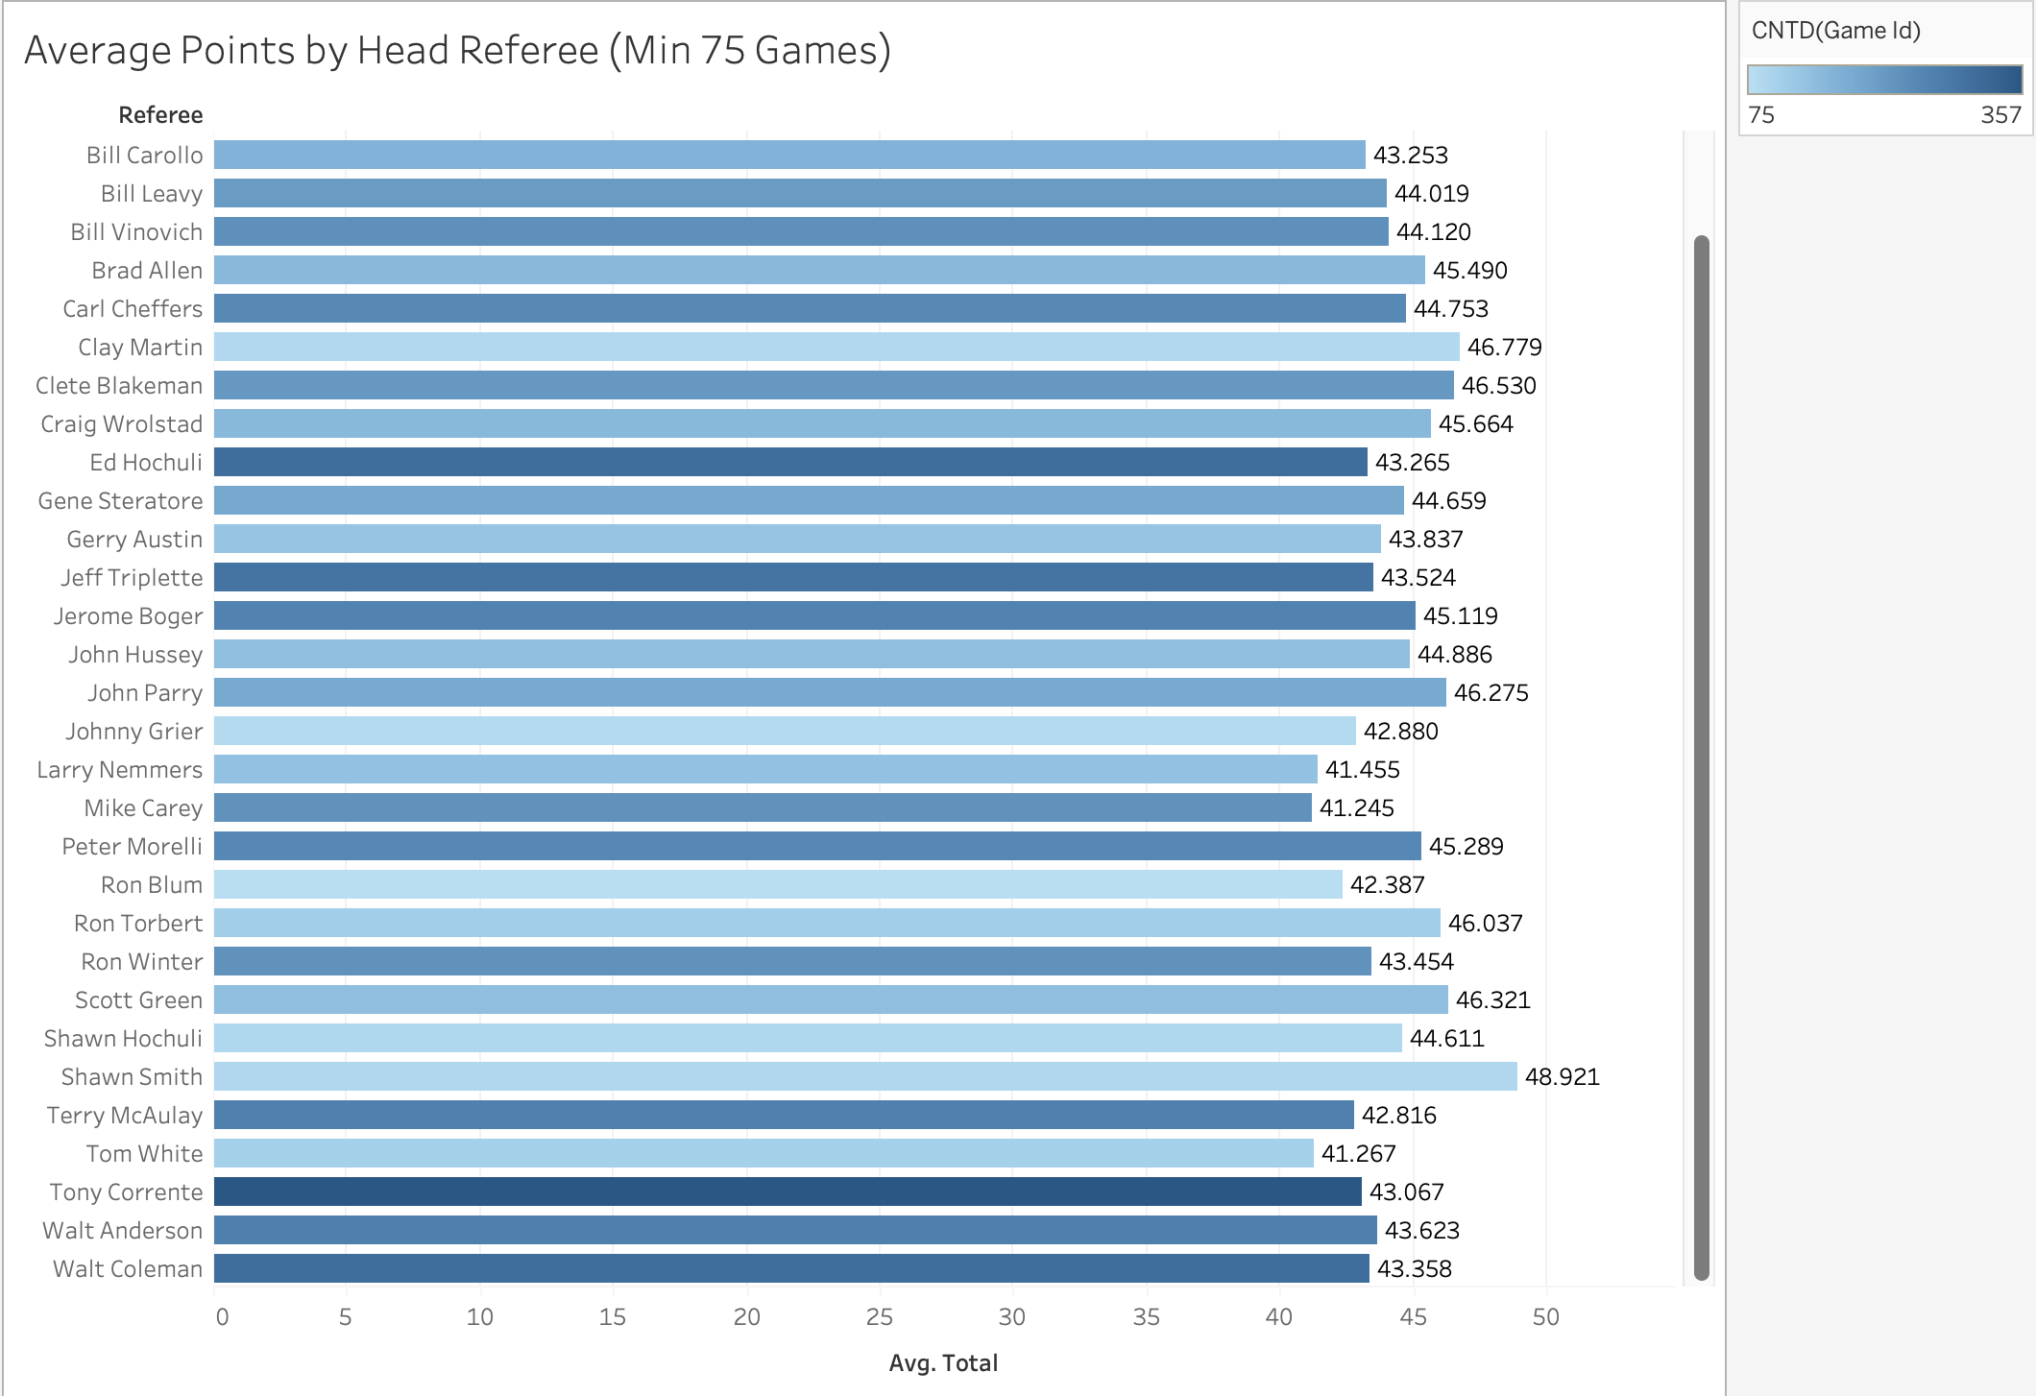
Key Findings: Refs as Silent Influencers
Fans often blame refs for influencing the game. Is there merit to these claims?
While points per game may differ depending on the refs selected for the game, this difference seems to be minimal.
Myth: Busted

Slide 13
Model Creation and Analysis
What I have now:
An attempt at Multi-Variable Regression
Next Steps:
Create a working notebook with two separate regressions.
Accuracy Metrics
Home MSE
Away MSE
ML Training Accuracy
ML Testing Accuracy
O/U MSE
Current Obstacles:
Notebook loading problems.
Multi-variable regression.
Areas for Future Improvement:
1. Hone neural network to find optimal number of layers, depth and principal components.
2. Incorporate metrics from “Games” dataset, including weather, home and away, field surface and location.
Many of these have already been discovered through EDA, and now only need to be incorporated into the model.

Slide 14
Product Interface
Goal:
Streamlit App
Interface:
3 drop-down menus:
Home Team
Away Team
Year
Output
Expected winner (Moneyline)
Outcome confidence
Score Prediction
Difference in expected points (predicting spread)
90% confidence interval for each team’s expected points (to make more informed decisions).
Sum of expected points (predicting point total)
Vegas odds
For comparison between my odds and those set by bookmakers.

